Slide 1


Capstone Project 04
ONLINE RETAIL
STORE
BY GHANSHYAM SINGH SHAKTAWAT

Slide 2
TABLE OF CONTENT
INTRODUCTION
PROBLEM STATEMENT
STRATEGY
HYPOTHESIS TESTING
MODEL IMPLEMENTATION
SUMMARY

Slide 3


INTRODUCTION
In this project, we delve into the data of an online retail store, conducting diverse data mining processes to extract valuable insights. The exploration involves hypothesis testing using Z-tests to assess significant patterns. Subsequently, in model implementation, we employ unsupervised learning through K-means clustering. This technique aims to unveil hidden structures within the data, contributing to a comprehensive understanding of customer behavior and facilitating targeted strategies for marketing, inventory optimization, and business growth in the dynamic online retail landscape.

Slide 4
PROBLEM STATEMENT
In this project, your task is to identify major customer segments on a transnational data set which contains all the transactions occurring between 01/12/2010 and 09/12/2011 for a UK-based and registered non-store online retail. The company mainly sells unique all-occasion gifts. Many customers of the company are wholesalers.

Slide 5

Model Implementation
STRATEGY
Model 1 employs K-means clustering for insightful data segmentation.
Model 1
Hypothesis Testing
Conducting hypothesis testing on three attributes:
unit price (5 null values),
quantity (10 null values), and
final sell (15 null values).
These tests aim to assess significant patterns within the data, providing insights into potential relationships and aiding in the refinement of strategies for pricing optimization, inventory management, and overall business performance.
Model 2 utilizes cross-validation and hyperparameter tuning, leveraging an elbow model for optimal parameter selection.
Model 2
Model 3
Model 3 applies K-means clustering, visualizing data relationships through a dendrogram.

Slide 6
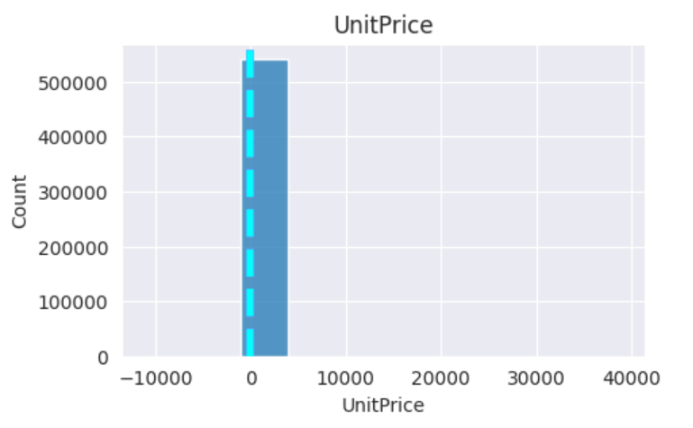
HYPOTHESIS TESTING 1
Z Test
Null Value 5
Null Value Accepted
Alternate value Rejected

Slide 7
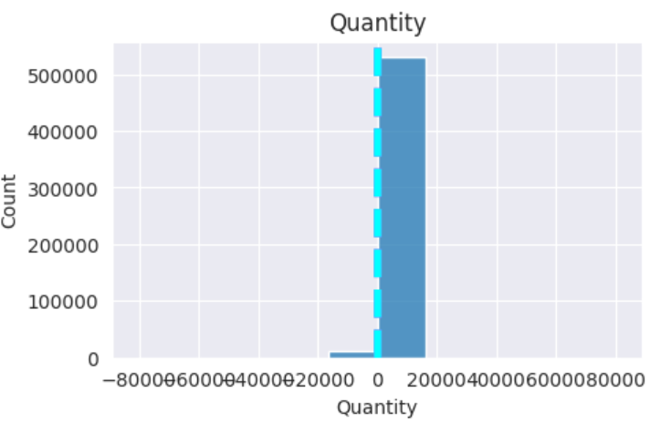
HYPOTHESIS TESTING 2
Z Test
Null Value 10
Null Value Accepted
Alternate value Rejected

Slide 8
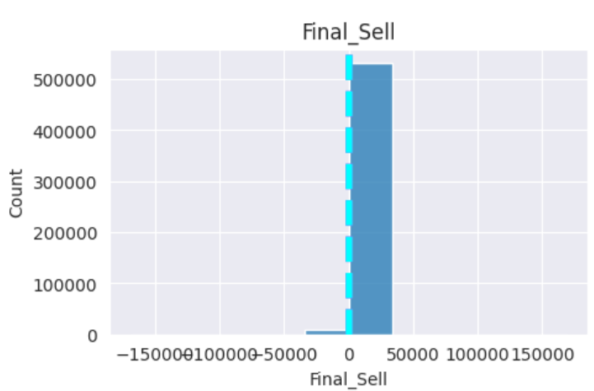
HYPOTHESIS TESTING 3
Z Test
Null Value 15
Null Value Accepted
Alternate value Rejected

Slide 9
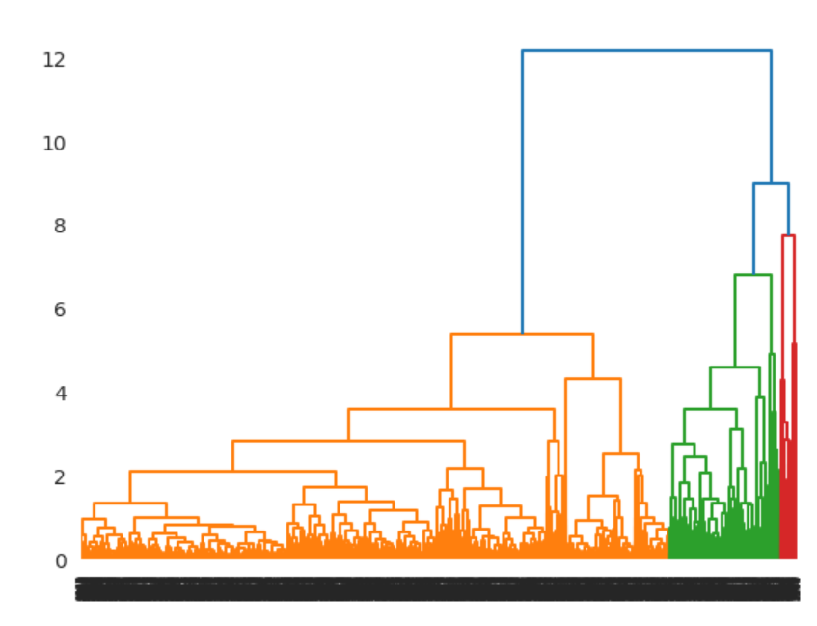
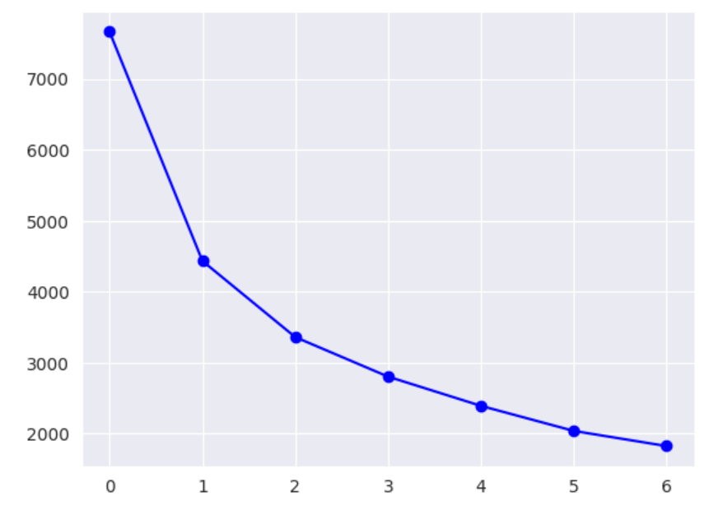
MODEL IMPLEMENTATION 01
K-Means Clustering
K-means clustering in the online store project groups customer data based on similarities, helping identify distinct customer segments for targeted marketing and personalized strategies, optimizing the online retail experience.

Slide 10
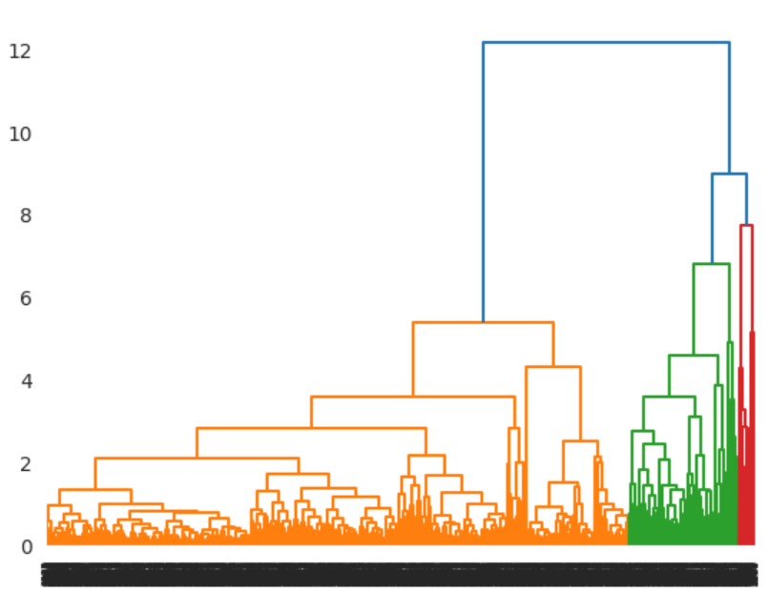
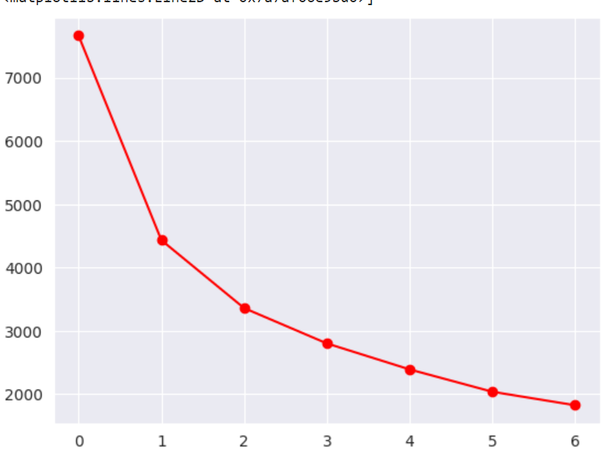
MODEL IMPLEMENTATION 02
K-Means Clustering
The elbow method in k-means clustering helps determine the optimal number of clusters by identifying the "elbow" point where further cluster addition provides diminishing returns, aiding in selecting an efficient and meaningful segmentation for improved insights in the online retail context.

Slide 11
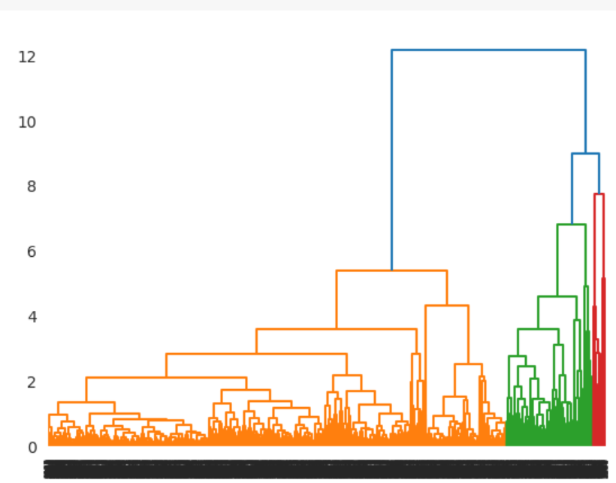
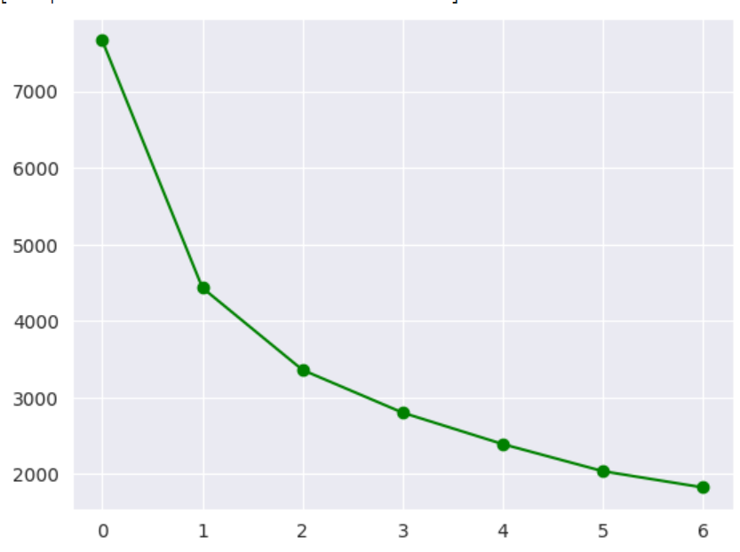
MODEL IMPLEMENTATION 03
K-Means Clustering
The dendrogram method visually represents hierarchical relationships in k-means clustering, showcasing data linkage through a tree-like structure. It aids in identifying optimal cluster numbers and understanding the hierarchical organization of data patterns for enhanced segmentation and interpretation in the context of the online retail project.

Slide 12

SUMMARY
The hypotheses and models applied contribute to a holistic understanding of the dataset. Hypothesis testing provided insights into attribute patterns. K-means clustering models identified hidden structures, informing strategies. Cross-validation and hyperparameter tuning enhanced model accuracy. Overall, these approaches collectively enrich our comprehension of the data, guiding informed decisions for marketing, inventory, and overall business strategies in the online retail domain.

Slide 13
THANKYOU!
BY GHANSHYAM SINGH SHAKTAWAT

